Slide 1



AI Master Class series – Day 12
Image Classification using CNN

Slide 2
Image Classification.
Image classification is a supervised learning problem: define a set of target classes (objects to identify in images), and train a model to recognize them using labeled example photos.

Slide 3
Block Diagram – Workflow of Image Classification CNN.
Dataset Creation
Train, Test, Val
CNN Design
Pre-Processing
Training - Model
Load Model - Test
Pre-process Input Image
Classification

Slide 4
CNN.
0
Convolutional Layer
1
Flattening
Pooling
Input
Output

Slide 5
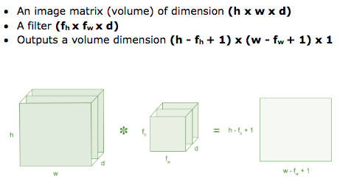
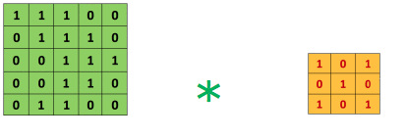
Convolution - Process.

Slide 6
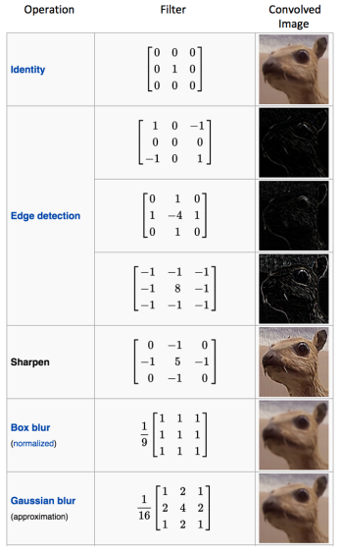
Convolution - Filter.

Slide 7
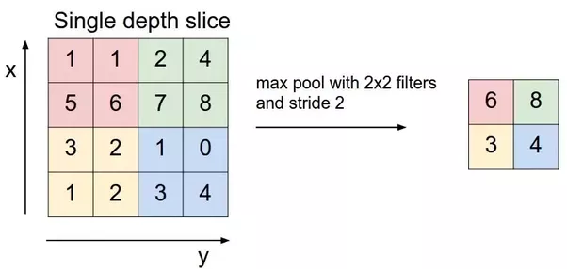
Pooling – Max Pooling.

Slide 8
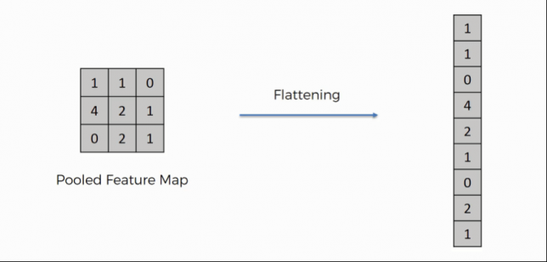
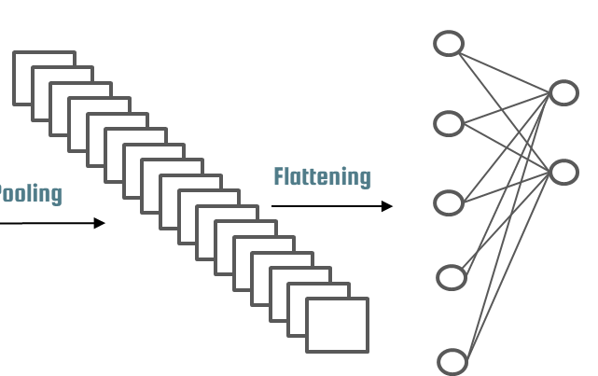
Flattening.

Slide 9
Fully Connected.
Dense
model.add(Dense(units = 128, activation = 'relu'))
Dense - Fully connected layer,
Units - Number of nodes present in a hidden layer
Activation function: rectifier function.
Output Layer.
classifier.add(Dense(units = 1, activation = 'sigmoid'))
Units = 1 - Binary classification
Activation function - Sigmoid, gives binary output ‘0’ or ‘1’.

Slide 10
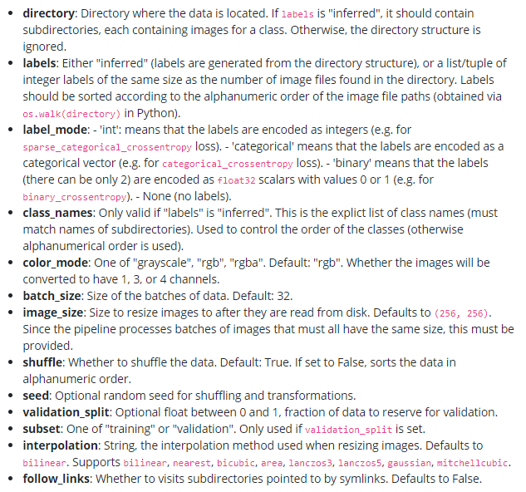
Compiling.
classifier.compile(optimizer = 'adam', loss = 'binary_crossentropy', metrics = ['accuracy'])
Pre-Processing – Image Datagenerator
image_dataset_from_directory(
directory,
labels="inferred",
label_mode="int",
class_names=None,
color_mode="rgb",
batch_size=32,
image_size=(256, 256),
shuffle=True,
seed=None,
validation_split=None,
subset=None,
interpolation="bilinear",
follow_links=False,
)

Slide 11
Model Train - Fit.
model.fit_generator(training_set,
steps_per_epoch = 10,
epochs = 25,
validation_data = val_set,
validation_steps = 2)
Steps_per_epoch – No. of Image in Training Dataset / Batch Size
Epoch – Iteration
Validation_steps – No. of Image in Validation Dataset / Batch Size

Slide 12

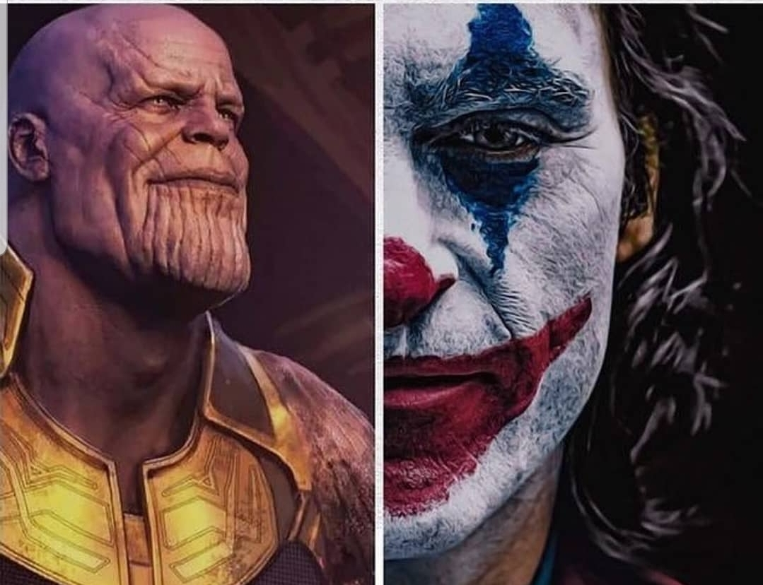
Image Classification of THANOS & JOKER

Slide 13
Collecting Dataset Image From Google based on Keyword
! BONUS !
Installing Libraries
Simple Image Download: pip install simple_image_download

Slide 14
Source Code for Collecting Image from Google & Save it in Local directory
from simple_image_download import simple_image_download as simp
response = simp.simple_image_download
response().download('batmanjoker', 5)
print(response().urls('batmanjoker', 45))
#response().download('batmanjoker', 5,extensions={'.jpg'})
#print(response().urls('batmanjoker', 5,extensions={'.jpg'}))

Slide 15
Renaming Complete Images present in the Folder to specific Format

Slide 16
Source Code to rename images present in directory
import os
os.chdir('D:\\MasterClass\\Artificial_Intelligence\\Day12\\Dataset\\test\\IronMan\\')
i=1
for file in os.listdir():
src=file
dst="1"+"_"+str(i)+".jpg"
os.rename(src,dst)
i+=1

Slide 17
Image Classification of THANOS & JOKER

Slide 18
TRAINING IMAGE CLASSIFICATION USING CONVOLUTONAL NEURAL NETWORK

Slide 19
from keras.models import Sequential
from keras.layers import Conv2D
from keras.layers import MaxPooling2D
from keras.layers import Flatten
from keras.layers import Dense
from keras.preprocessing.image import ImageDataGeneratoN
model = Sequential()
model.add(Conv2D(32, (3, 3), input_shape = (64, 64, 3), activation = 'relu'))
model.add(MaxPooling2D(pool_size = (2, 2)))
model.add(Flatten())
model.add(Dense(units = 128, activation = 'relu'))
model.add(Dense(units = 1, activation = 'sigmoid'))
model.compile(optimizer = 'adam', loss = 'binary_crossentropy', metrics = ['accuracy'])
train_datagen = ImageDataGenerator(rescale = 1./255,
shear_range = 0.2,
zoom_range = 0.2,
horizontal_flip = True)
test_datagen = ImageDataGenerator(rescale = 1./255)
training_set = train_datagen.flow_from_directory('Dataset/train',
target_size = (64, 64),
batch_size = 8,
class_mode = 'binary')
val_set = test_datagen.flow_from_directory('Dataset/val',
target_size = (64, 64),
batch_size = 8,
class_mode = 'binary')
model.fit_generator(training_set,
steps_per_epoch = 10,
epochs = 25,
validation_data = val_set,
validation_steps = 2)
model_json = model.to_json()
with open("model.json", "w") as json_file:
json_file.write(model_json)
model.save_weights("model.h5")
print("Saved model to disk")

Slide 20
TESTING TRAINED MODEL

Slide 21
from keras.models import model_from_json
import numpy as np
from keras.preprocessing import image
import os
json_file = open('model.json', 'r')
loaded_model_json = json_file.read()
json_file.close()
model = model_from_json(loaded_model_json)
model.load_weights("model.h5")
print("Loaded model from disk")
def classify(img_file):
img_name = img_file
test_image = image.load_img(img_name, target_size = (64, 64))
test_image = image.img_to_array(test_image)
test_image = np.expand_dims(test_image, axis=0)
result = model.predict(test_image)
if result[0][0] == 1:
prediction = 'Thanos'
else:
prediction = 'Joker'
print(prediction,img_name)
path = 'D:/MasterClass/Artificial_Intelligence/Day12/Dataset/test'
files = []
for r, d, f in os.walk(path):
for file in f:
if '.jpeg' in file:
files.append(os.path.join(r, file))
for f in files:
classify(f)
print('\n')

Slide 22
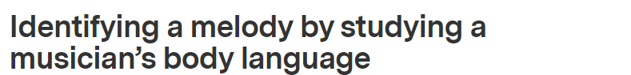
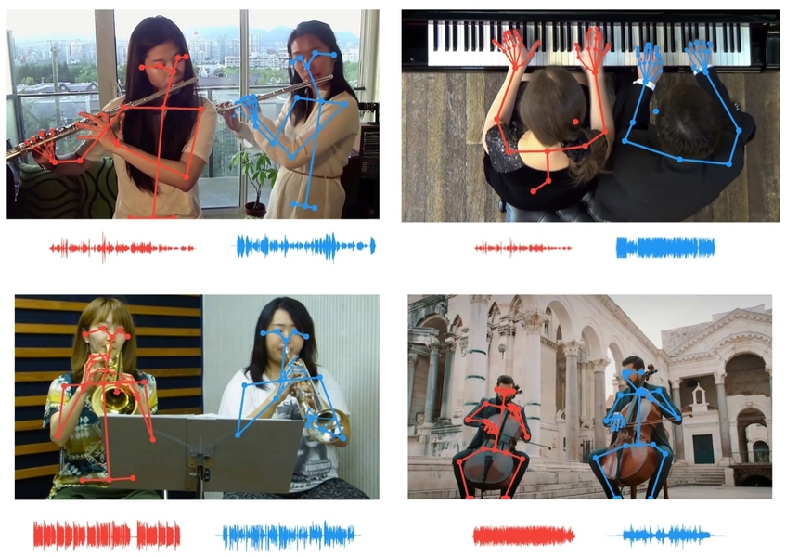
AI News – Day 12. June - 2020
Music gesture artificial intelligence tool developed at the MIT-IBM Watson AI Lab uses body movements to isolate the sounds of individual instruments.
A new artificial intelligence tool developed by the MIT-IBM Watson AI Lab leverages the virtual eyes and ears of a computer to separate similar sounds that are tricky even for humans to differentiate. The tool improves on earlier iterations by matching the movements of individual musicians, via their skeletal keypoints, to the tempo of individual parts, allowing listeners to isolate a single flute or violin among multiple flutes or violins.

Slide 23
Thanks!
Tomorrow session
Do you have any questions?
sanjay@pantechmail.com
www.pantechsolutions.net
Hand Gesture Recognition

Slide 24
Day-11 Agenda.
01.
02.
03.
Image Classification
Basic Syntax
Image Classification
04.
Q & A
Image Classification & its Types
Basic Syntax for Image classification
Training & Testing Image classification of
Thanos & Joker

